Slide 1

Green Pace
Security Policy Presentation
Developer: Jordan Charlot
Project Two
CS 405 • PROJECT TWO

Slide 2


OVERVIEW: DEFENSE IN DEPTH
Why the policy is needed
Green Pace was already using security practices, but they were not all written in one place.
This policy puts the rules together so the whole team can follow the same ones.
Defense in depth means one security check is not enough. If one misses a problem, another may catch it.
Main areas to protect: user input, memory, SQL, network traffic, accounts, and saved data.
Goal: find problems early and make attacks harder.
GREEN PACE • SECURE DEVELOPMENT POLICY
2

Slide 3
THREATS MATRIX
Level 5 gets fixed first.
Level 4 comes next because these problems can affect memory, data, or how the program runs.
Levels 2 and 3 still get fixed, just after the higher risks.
Likely STD-004-CPP SQL injection Level 5 | Priority STD-001, 002, 003, 004, 005, 008, 009, 010
Lower priority STD-006-CPP — Level 3 STD-007-CPP — Level 2 | Unlikely STD-007-CPP Exception issue Level 2
GREEN PACE • SECURE DEVELOPMENT POLICY
3

Slide 4
10 PRINCIPLES
Principles 1-5
1. Validate Input Data — 001, 002, 003, 004, 010 2. Heed Compiler Warnings — 001, 002, 005, 006, 008 3. Design for Security Policies — policy-wide 4. Keep It Simple — 003, 005, 007, 008, 009, 010 5. Default Deny — access / Triple-A policy
Principles 6-10
6. Least Privilege — access / Triple-A policy 7. Sanitize Data Sent to Other Systems — 004 8. Practice Defense in Depth — 004 + policy layers 9. Quality Assurance — 002, 003, 005, 006, 007, 008, 009, 010 10. Adopt a Secure Coding Standard — 001 through 010
Principles 3, 5, and 6 are mostly used in the system and access rules, not one C++ rule.
GREEN PACE • SECURE DEVELOPMENT POLICY
4

Slide 5
CODING STANDARDS: PRIORITY ORDER
1
STD-004-CPP | L5
SQL injection — keep input out of SQL commands
6
STD-009-CPP | L4
Resource management — automatic cleanup
2
STD-003-CPP | L4
String correctness — limit string input
7
STD-002-CPP | L4
Data value — check math before it runs
3
STD-005-CPP | L4
Memory protection — check pointers before use
8
STD-001-CPP | L3
Data type — use safe data types
4
STD-010-CPP | L4
Bounds checking — check index values
9
STD-006-CPP | L3
Assertions — use assertions correctly
5
STD-008-CPP | L4
Uninitialized memory — initialize before use
10
STD-007-CPP | L2
Exceptions — catch by reference
I ranked the standards by threat level first. SQL injection is first because it is the only Level 5 rule.
GREEN PACE • SECURE DEVELOPMENT POLICY
5

Slide 6
ENCRYPTION POLICIES
At rest
Encrypt sensitive data saved in files, databases, backups, and devices. Store the keys away from the data.
In flight
Use TLS or another approved encrypted connection. Do not send sensitive data with plain HTTP.
In use
Only let approved users or programs read sensitive data in memory. Clear secrets when they are not needed.
Only approved users or services should have access to keys and secrets.
GREEN PACE • SECURE DEVELOPMENT POLICY
6

Slide 7
TRIPLE-A POLICIES
Authentication
Check who the user or service is. Use separate accounts, strong passwords, and MFA when needed.
Authorization
After login, only give the access needed for the job. Log changes to roles, files, and database access.
Accounting
Keep logs for logins, new users, access changes, database changes, and sensitive file access.
Do not put passwords or secret keys in logs.
GREEN PACE • SECURE DEVELOPMENT POLICY
7

Slide 8
Does a valid index return the right value?
STD-010-CPP • Bounds Checking • GoogleTest
TEST(BoundsTest, ValidIndex) { std::vector<int> v{10, 20, 30}; EXPECT_EQ(v.at(1), 20); }
Test type
Positive test
Result
Expected: PASS
Why it matters
A safe index should still work.
Take it further
Test a few more normal indexes.
Run this test in Visual Studio Test Explorer and take a screenshot of the result.
GREEN PACE • SECURE DEVELOPMENT POLICY
8

Slide 9
Does the last valid index still work?
STD-010-CPP • Bounds Checking • GoogleTest
TEST(BoundsTest, LastValidIndex) { std::vector<int> v{10, 20, 30}; EXPECT_EQ(v.at(v.size() - 1), 30); }
Test type
Positive boundary test
Result
Expected: PASS
Why it matters
The last item is where off-by-one mistakes often happen.
Take it further
Also test index 0 and a vector with one item.
Run this test in Visual Studio Test Explorer and take a screenshot of the result.
GREEN PACE • SECURE DEVELOPMENT POLICY
9

Slide 10
Does index equal to size get rejected?
STD-010-CPP • Bounds Checking • GoogleTest
TEST(BoundsTest, SizeIndexThrows) { std::vector<int> v{10, 20, 30}; EXPECT_THROW(v.at(v.size()), std::out_of_range); }
Test type
Negative boundary test
Result
Expected: PASS
Why it matters
An index equal to the size is already outside the vector.
Take it further
Run this test every time the code is changed.
Run this test in Visual Studio Test Explorer and take a screenshot of the result.
GREEN PACE • SECURE DEVELOPMENT POLICY
10

Slide 11
Does a very large index get rejected?
STD-010-CPP • Bounds Checking • GoogleTest
TEST(BoundsTest, LargeIndexThrows) { std::vector<int> v{10, 20, 30}; EXPECT_THROW(v.at(1000), std::out_of_range); }
Test type
Negative test
Result
Expected: PASS
Why it matters
A very large bad index should be blocked.
Take it further
Try more random bad index values.
Run this test in Visual Studio Test Explorer and take a screenshot of the result.
GREEN PACE • SECURE DEVELOPMENT POLICY
11

Slide 12
Does an empty vector reject index 0?
STD-010-CPP • Bounds Checking • GoogleTest
TEST(BoundsTest, EmptyVectorThrows) { std::vector<int> v; EXPECT_THROW(v.at(0), std::out_of_range); }
Test type
Negative edge case
Result
Expected: PASS
Why it matters
An empty vector has no valid index, even 0.
Take it further
Use the same tests on the real Green Pace function later.
Run this test in Visual Studio Test Explorer and take a screenshot of the result.
GREEN PACE • SECURE DEVELOPMENT POLICY
12

Slide 13

AUTOMATION SUMMARY
PRE-PRODUCTION
Design rules → compile → static checks → GoogleTest
BUILD GATE
Stop the build when a serious problem is found.
PRODUCTION
Keep logs and alerts running after release.
GREEN PACE • SECURE DEVELOPMENT POLICY
13

Slide 14
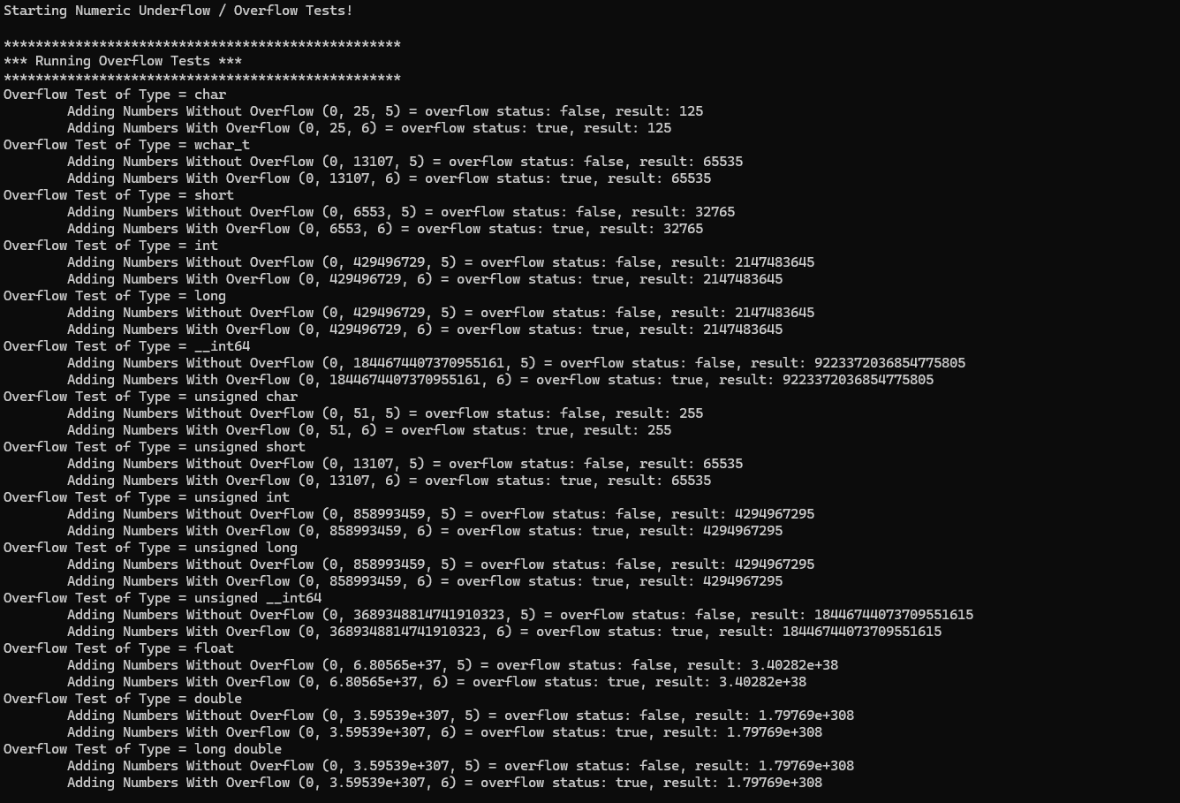
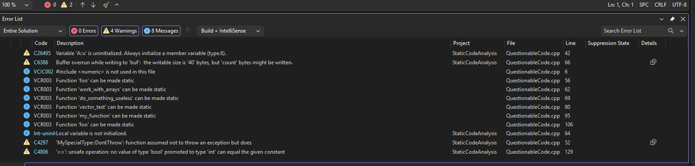
TOOLS AND EXTERNAL TESTING
Visual Studio Code Analysis: runs with the build
Cppcheck 2.21.0: checks memory and logic problems
Semgrep: checks for unsafe SQL patterns
GoogleTest: runs the same unit tests again
Visual Studio exercise: 0 errors, 4 warnings, 8 messages
Numeric overflow exercise: safe values were false; overflow cases were true.
Different tools find different problems. Green Pace should use more than one.
GREEN PACE • SECURE DEVELOPMENT POLICY
14

Slide 15
RISKS AND BENEFITS
SQL injection
Act now: use prepared statements. Do not build SQL with user input. Wait: bad input could reach the database.
Memory and bounds
Act now: check ranges and pointers. Use safer memory handling. Wait: crashes or bad memory access can still happen.
Access and monitoring
Act now: use MFA, limited access, and useful logs. Wait: a stolen account may be harder to stop.
Fix Level 5 and Level 4 problems first. Then make the checks automatic.
GREEN PACE • SECURE DEVELOPMENT POLICY
15

Slide 16
RECOMMENDATIONS: CURRENT GAPS
Dependency risk
Add a tool that checks third-party libraries and keep an SBOM list.
Key management
Write clear rules for where keys are stored, when they are changed, and when they are removed.
Response timing
Set deadlines for fixing problems based on risk.
Authentication monitoring
Require MFA for higher-risk access and alert on strange login activity.
Real-world example: a 2025 investigation of 23andMe found problems with MFA and detecting credential-stuffing attacks. The attack continued for months. (OPC & ICO, 2025)
GREEN PACE • SECURE DEVELOPMENT POLICY
16

Slide 17
CONCLUSION: KEEP THE POLICY CURRENT
Keep SEI CERT as the C/C++ coding rules.
Use NIST SSDF for the secure development process.
Use OWASP for web problems such as injection and login security.
Add dependency scans, secret scans, and more security tests to CI/CD.
Review the policy every year and after a major incident or big tool change.
The policy and the tools should follow the same security rules.
NIST SSDF says security practices should be part of the software development life cycle. (NIST, 2022)
GREEN PACE • SECURE DEVELOPMENT POLICY
17

Slide 18
REFERENCES
Carnegie Mellon University Software Engineering Institute. (n.d.). SEI CERT C++ Coding Standard.
https://wiki.sei.cmu.edu/confluence/display/cplusplus/SEI+CERT+C%2B%2B+Coding+Standard
Cppcheck. (n.d.). Cppcheck manual.
https://cppcheck.sourceforge.io/manual.html
Google. (n.d.). GoogleTest primer.
https://google.github.io/googletest/primer.html
Microsoft. (n.d.). C++ code analysis warnings.
https://learn.microsoft.com/en-us/cpp/code-quality/
National Institute of Standards and Technology. (2022). Secure Software Development Framework (SSDF) Version 1.1 (NIST SP 800-218).
https://doi.org/10.6028/NIST.SP.800-218
OWASP Foundation. (2025). A05: Injection. OWASP Top 10:2025.
https://owasp.org/Top10/2025/A05_2025-Injection/
Office of the Privacy Commissioner of Canada & Information Commissioner’s Office. (2025). Joint investigation into a data breach at 23andMe.
https://www.priv.gc.ca/en/opc-actions-and-decisions/investigations/investigations-into-businesses/2025/pipeda-2025-001/
Green Pace. (2026). Green Pace Secure Development Policy, version 1.2 [Course project].
GREEN PACE • SECURE DEVELOPMENT POLICY
18

